Slide 1
Behavior Driven Development
Venkata Shyam

Slide 2
Agenda
BDD Intro
Project Myths
Origin of BDD
Test-Last & Test-First Approach
TDD vs BDD
BDD Process & Architecture
Advantages of BDD
BDD tools- Cucumber, Behave
Q&A

Slide 3
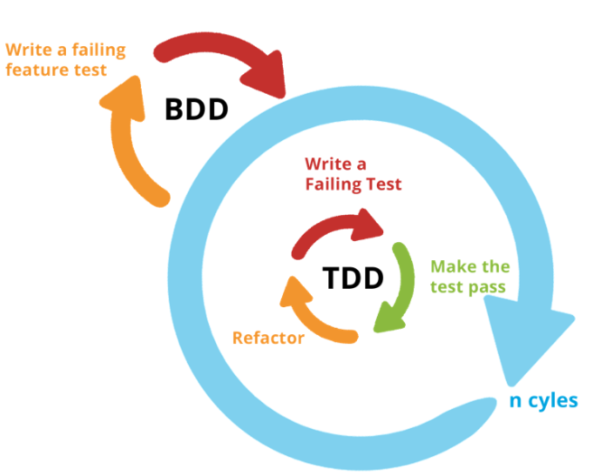
Behavior-driven development (or BDD)
Originally emerged from Test Driven Development (TDD)
An agile software development technique
Encourages collaboration between developers, QA and non-technical or business participants in a software project.
Dan North- Responsible for the evolution of BDD

Slide 4
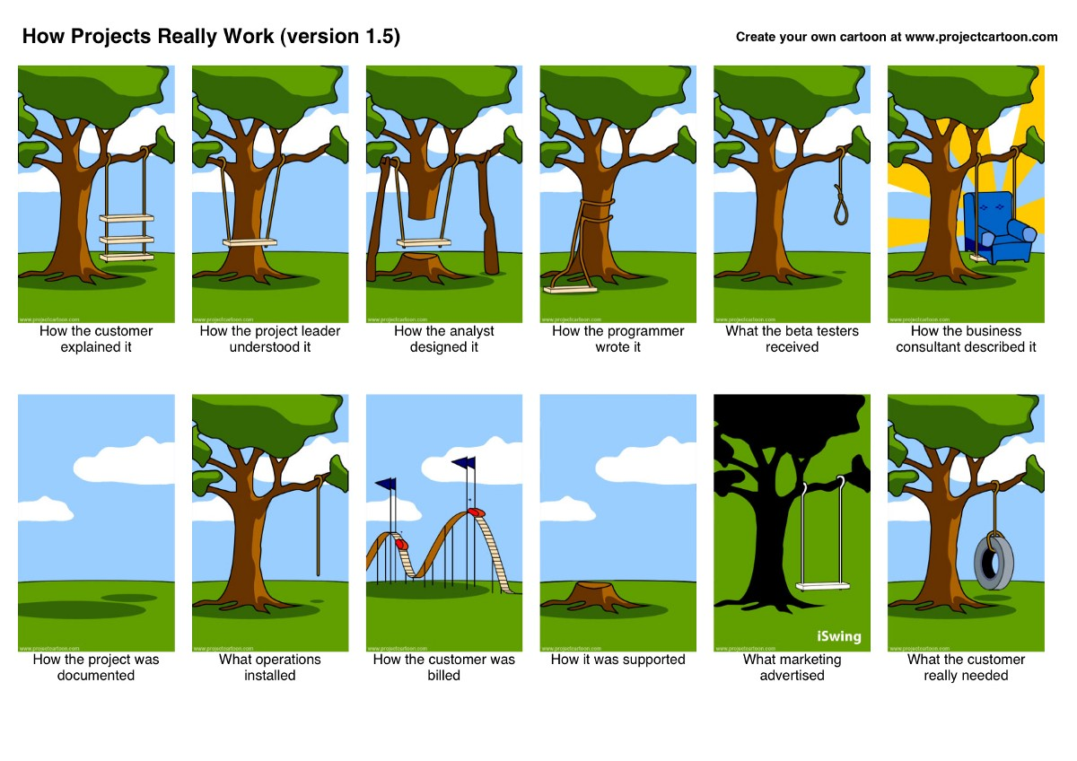
Project Myths

Slide 5
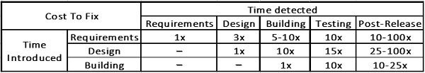
Origin of BDD
The cost to fix a defect increases if the defect is not detected at the right time and fixed as and when it is detected.
This shows that Requirements must be obtained correctly, it would be expensive to fix the defects due to misunderstanding
A development approach that can take care of the above-mentioned requirements is BDD.

Slide 6
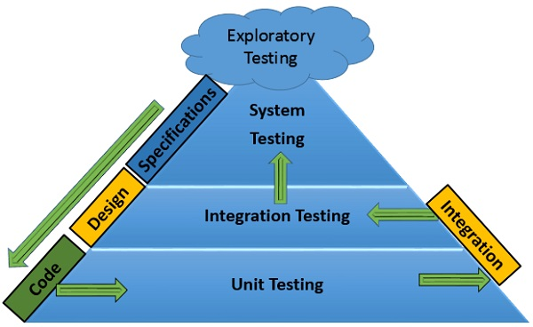
Test-Last Approach
Challenges-
Delays in the completion of the stage.
Tight time schedules.
Focus on delivery on time, skipping testing.
Results −
Compromising on the quality of the product delivered.
High-costs in fixing the defects, post delivery.
Inability to obtain customer satisfaction, effecting credibility.

Slide 7
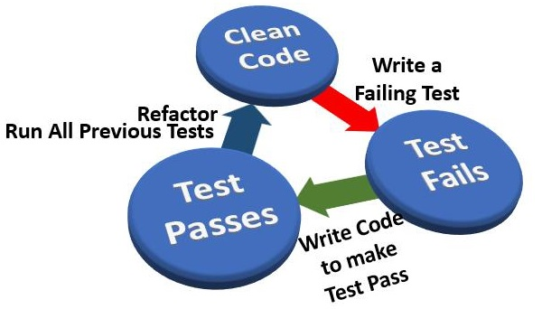
Test-First Approach
Replaces the inside-out (write code and then test) to outside-in (write test and then code) way of development. Test Driven Development
TDD is used to develop the code guided by Unit tests.
Technique: Red-Green-Refactor cycle →
Red − Writing a test that fails.
Green − Writing code to pass the test.
Refactor − Remove duplication and improve the code to the acceptable standards.

Slide 8
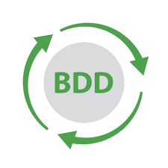
TDD vs BDD
Problems with TDD−
Where to start?
What to test and what not to test?
How much to test in one go?
What to call their tests?
How to understand why a test fails?
The solution to all these problems is
Difference between TDD and BDD−
TDD describes how the software works.
BDD −
Describes how the end user uses the software.
Fosters collaboration and communication.
Emphasizes on examples of behavior of the System.
Aims at the executable specifications derived from the examples

Slide 9
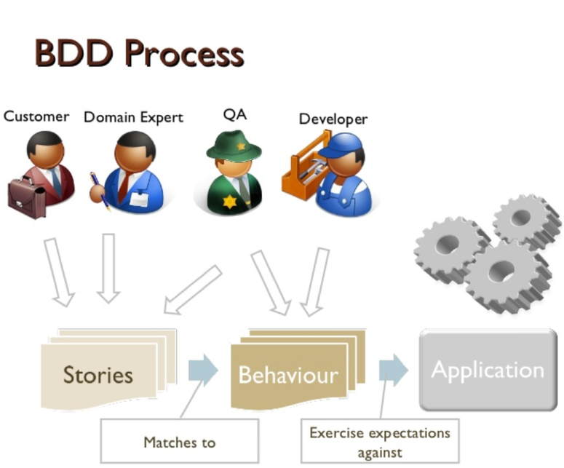
BDD Process at High level

Slide 10
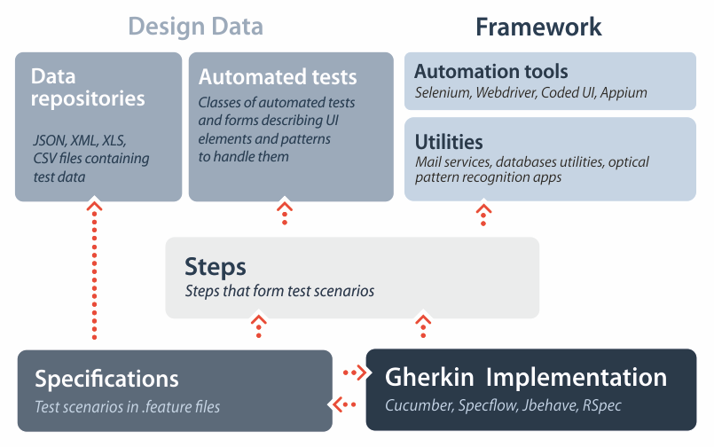
BDD Architecture

Slide 11
Advantages of BDD
Controlled, Robust, Scalable and Reliable
Controllable by any level of management- Lower and Upper
Better Collaboration across teams, Very clear documentation
WHY BDD?
Handles Agile changes easily
Absorbs any TDD Frameworks and Technologies and meets Acceptance standards
Supports different platforms and multiple languages
Test cases in a natural language that non-programmers can read, no technical knowledge required
Gherkin Style feature to define steps in Test scenarios-
Given, When, Then, And, But

Slide 12
BDD Tools
Cucumber
SpecFlow (.NET framework)
Behave (Python framework)
JBehave, Concordion (Java frameworks)
JBehave Web (Java framework with Selenium integration)
Lettuce (Python framework)
Behat, Kahlan (PHP frameworks)
DaSpec, Jasmine (JavaScript frameworks)
Squish GUI Tester (BDD GUI Testing Tool for JavaScript, Python, Perl, Ruby & TCL)
Spock (Groovy framework)
Yadda (Gherkin language support for frameworks such as Jasmine)

Slide 13
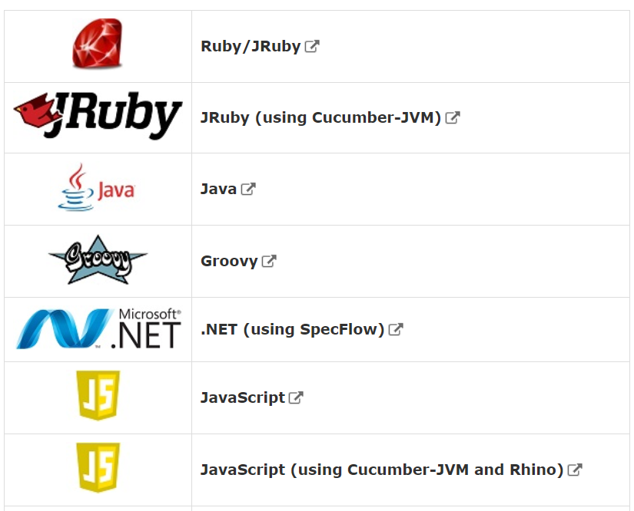
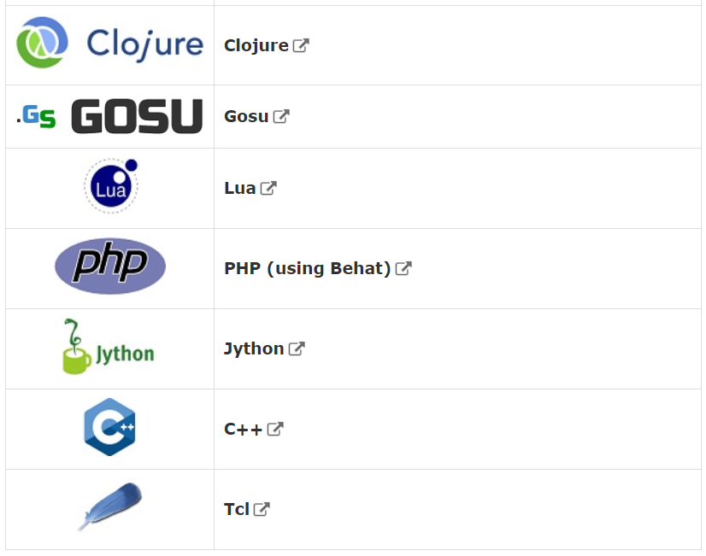
Cucumber
Cucumber is a free tool for executable specifications used globally.
Cucumber describe how software should behave in plain text based on acceptance criteria.
The text is written in a business-readable, domain-specific language and serves as documentation, automated tests and development-aid, all rolled into one format with collaboration.
We can use over forty different spoken languages (English, Chinese, etc.) with Cucumber.

Slide 14
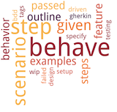
Behave framework
Behave (behavior-driven development framework) is a Python style framework.
behave uses tests written in a natural language style, backed up by Python code.
Installation- pip install behave
Behave works with three types of files stored in a directory called “features” −
feature files with your behavior scenarios.
“steps” directory with Python step implementations for the scenarios.
Optionally, some environmental controls (code to run before and after steps, scenarios, features or the whole shooting match).

Slide 15
Python Behave Steps
Install Behave
Make a directory called “features/”
In that features directory, create a feature file containing the test scenarios and steps in Gherkin style
Make a new directory called “features/steps/”
In that directory write the implementation logic for each of the steps mentioned in the feature file
Link the implemented logic with the feature steps
Run Behave
# -- FILE: features/example.feature
Feature: Showing off behave
Scenario: Run a simple test
Given we have behave installed
When we implement 5 tests
Then behave will test them for us!
# -- FILE: features/steps/example_steps.py
from behave import given, when, then, step
@given('we have behave installed’)
def step_impl(context):
pass
@when('we implement {number:d} tests’)
def step_impl(context, number):
# -- NOTE: number is converted into integer
assert number > 1 or number == 0
context.tests_count = number
@then('behave will test them for us!’)
def step_impl(context):
assert context.failed is False
assert context.tests_count >= 0

Slide 16
Feature Files (Gherkin)
A feature file has a natural language format describing a feature. They’re plain-text (UTF-8)
The “Given”, “When” and “Then” parts of the step form the actual steps mapped to Python step implementations.
Given − Establish context, When − Perform action, Then − Check outcome
If there are multiple Given or When steps underneath each other, you can use And or But.
Gherkin is a language, which is used to write Features, Scenarios, and Steps.

Slide 17
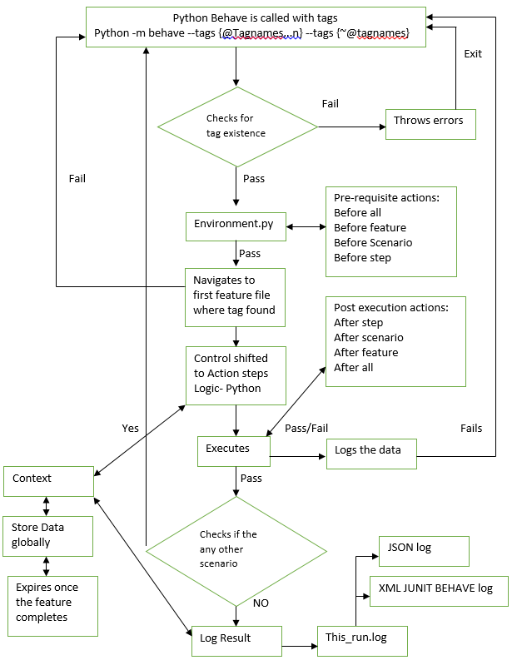
Python Behave framework : Flow Diagram

Slide 18
DEMO

Slide 19


Slide 20
Thank you

Slide 21
Sources- https://www.tutorialspoint.com/behavior_driven_development/
https://qanalysisblog.wordpress.com/2018/06/27/do-you-wish-to-learn-about-bdd/
https://codeburst.io/what-is-bdd-anyway-87b6ebaf619e
https://pypi.org/project/behave/ https://behave.readthedocs.io/en/latest/tutorial.html#features

